Slide 1

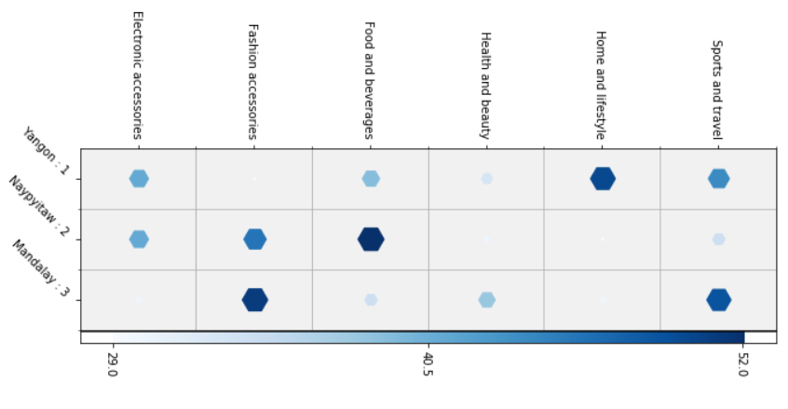
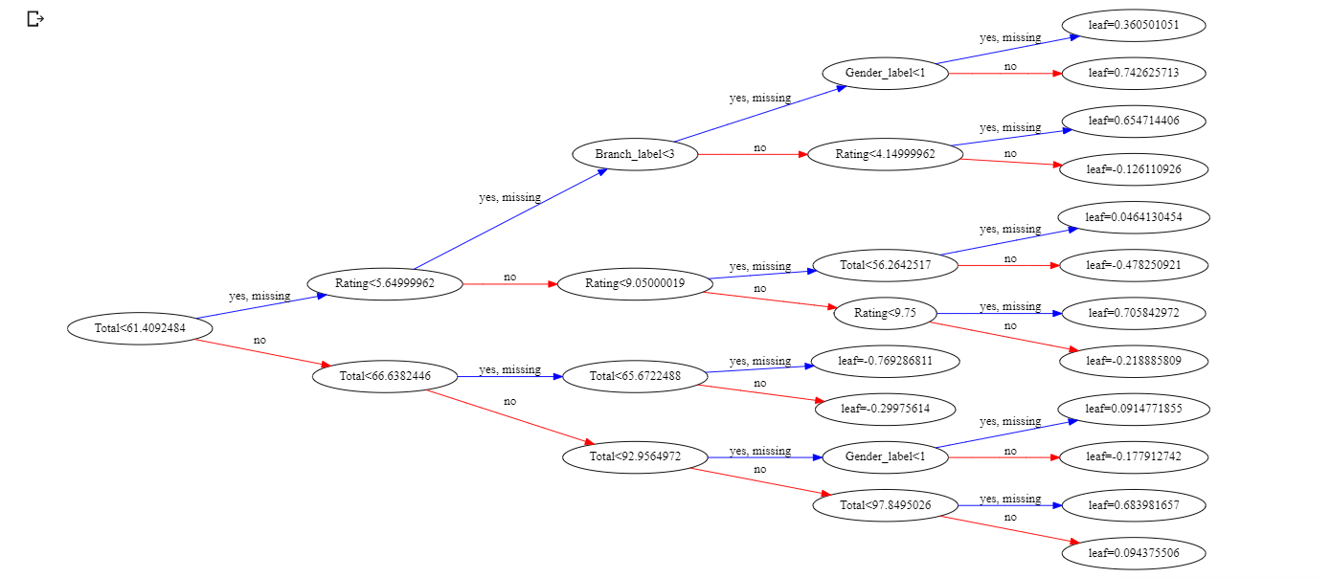
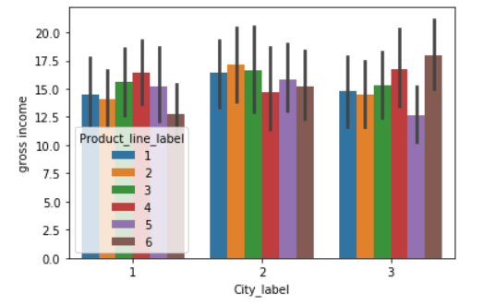
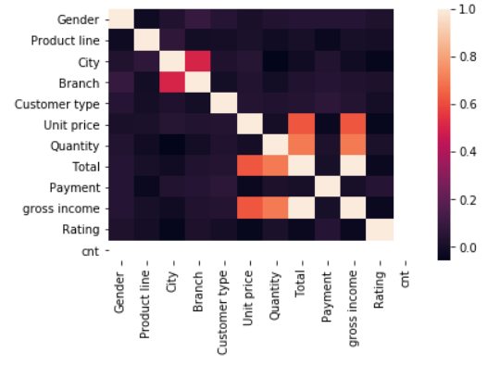
RETAIL SALES DATA ANALYSIS
Presented by : Ariga Tejasimha Srimanikanta Arjun Karimalammanavar, Rahul Akkineni
Advisor: Dr. Vahid Behzadan
Introduction
We have got the data from a Super market which is located in three different locations. we have to analyse the sales data from 3 months and predict the products sales throughout the year and recommendations to increase the sales based on Time Series Modelling and Location Analysis
We have considered these two scenario considering the base line conditions like weather is being same as three months whole year, number of holidays
If we do the analysis for the one location completely then we do the same methods for other two locations
We can perfom customer behaviour analysis from the data
Conclusions
Based on the location and time Series there is lot of promotional recommendations(sports & travel) and product embedding for Health & Beauty
Results
In time analysis we have noted from graph that Sales by the hour in the company Most of the item were sold around 14:00 hrs local time
we can see that food and beverages sales usually high in all three branches at evening especially around 19:00
Food and Beverages have the highest average rating while sports and travel the lowest
The top product line item type sold in the given dataset is Fashion Accessories is the highest while Health and beauty is the lowest
In location analysis we found that location B has lowest rating
References
www.stackoverflow.com
www.google.com
www.kaggle.com
Data and Methods
We have got the data from kaggle which is crisp enough and there is no need of any data cleaning procedures
We have used the methods like
KNN Model
Linear Regression
Logistic regression
Decision Tree
Correlation Matrix
XG Boost
Acknowledgements
We would like to extend our gratitude to Dr. Vahid who gave us the golden opportunity to try this super challenge, which helped us to study a few facts, explanatory ideas and do in addition studies on it.

